Slide 1
Improve Trading Strategies
Using Machine Learning
By Harrison, Darren, Khushboo, Leon, Liam

Slide 2
TABLE OF CONTENTS
01
02
ML MODELS
DATA PREP & TECHNICAL INDICATORS
03
04
ML RESULTS
FURTHER CONSIDERATION

Slide 3
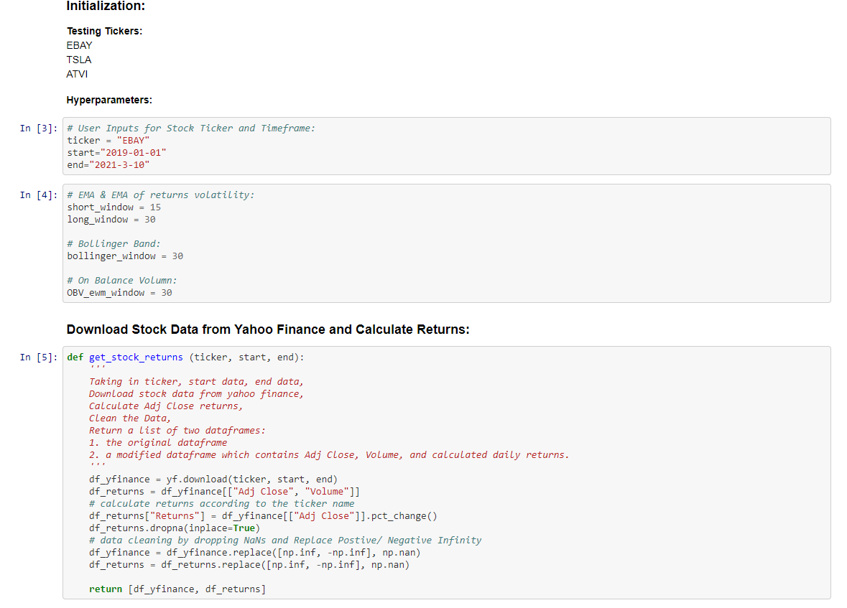
DATA PREPERATION, SELECTION & CLEANING USING YAHOO FINANCE

Slide 4
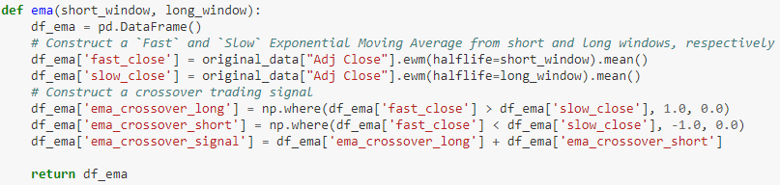
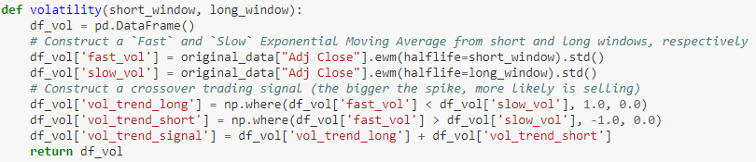
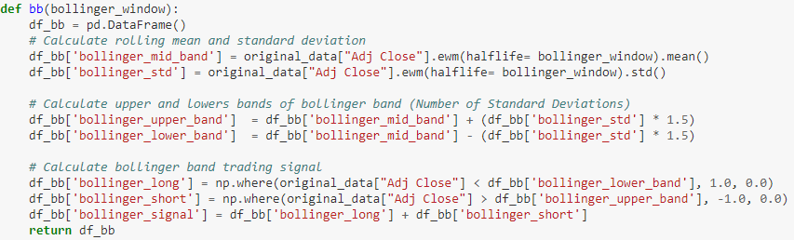
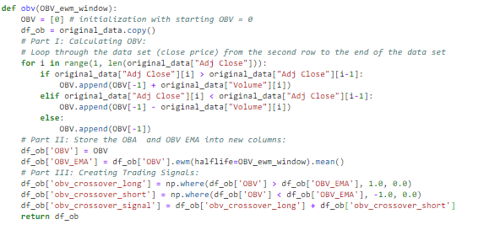
TECHNICAL INDICATORS OVERVIEW
EMA Cross Strat.
EMA of Daily Return Volatility
Bollinger Bands
On Balance Volume

Slide 5
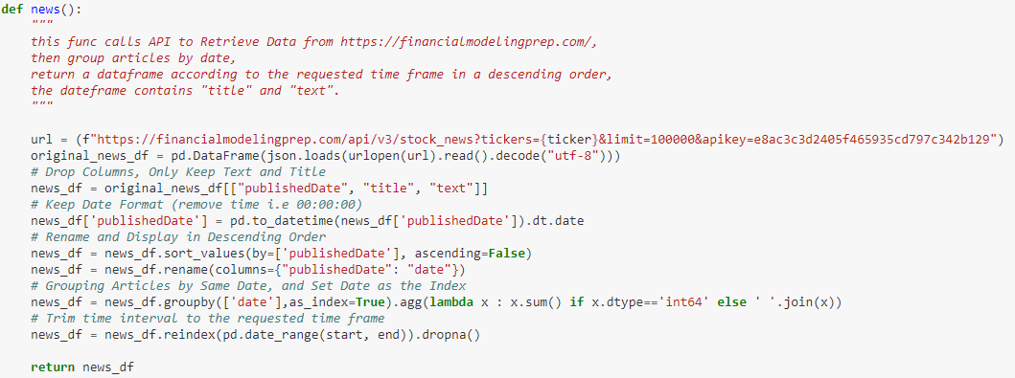
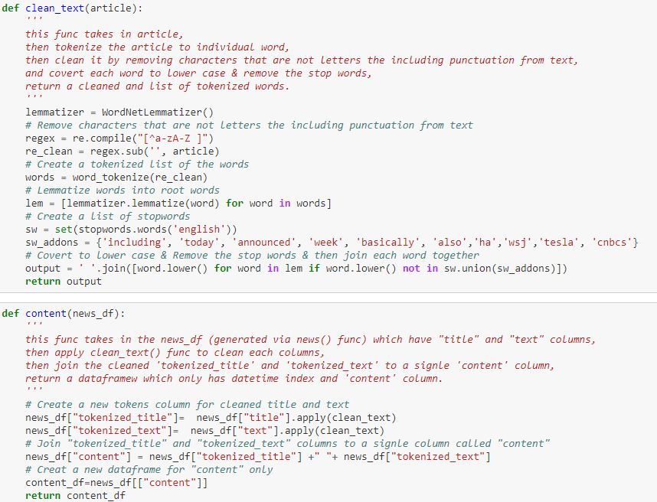
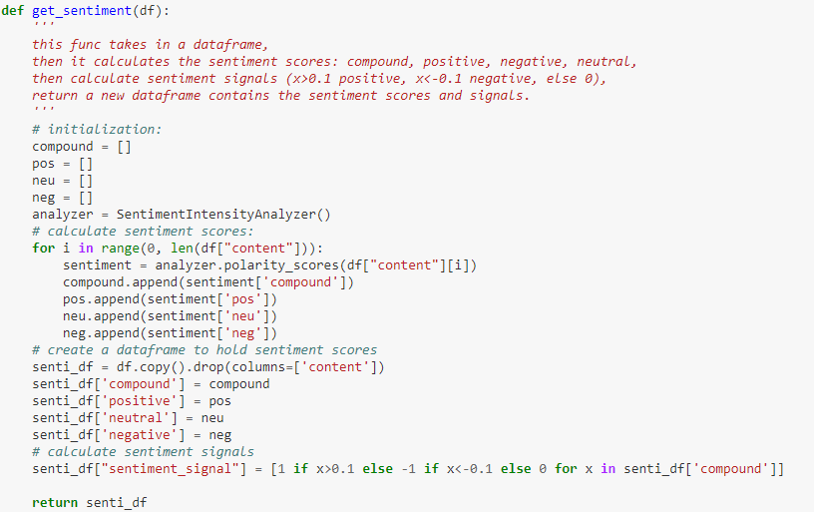
SCORING SENTIMENT USING VADAR
STEP 1: GET NEWS DATA
- if the compound score is greater than or equal to 0.1, the news will be positive
- if the compound score is below -0.1, the news will be negative.
STEP 2: PREPARE NEWS DATA
STEP 3: SENTIMENT ANALYSIS

Slide 6
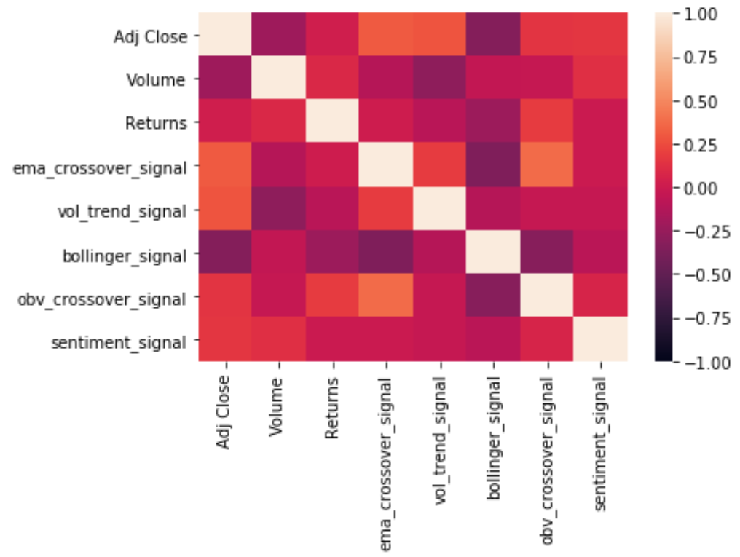
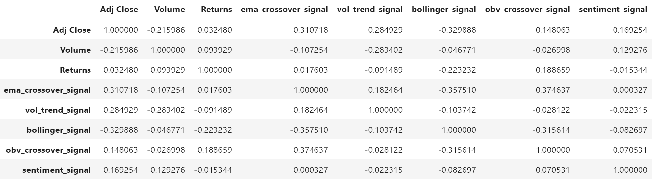
TECHNICAL INDICATORS CORRELATIONS

Slide 7
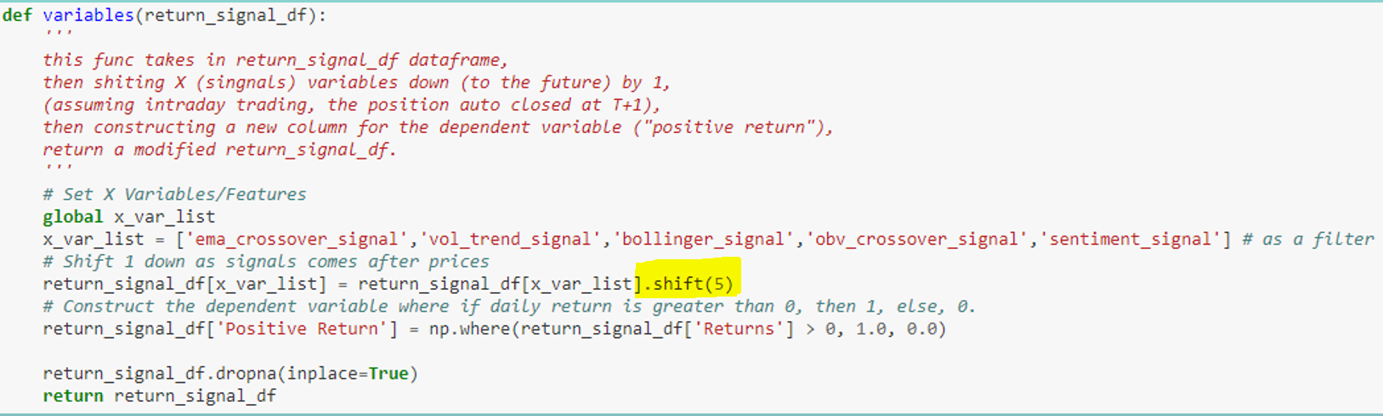
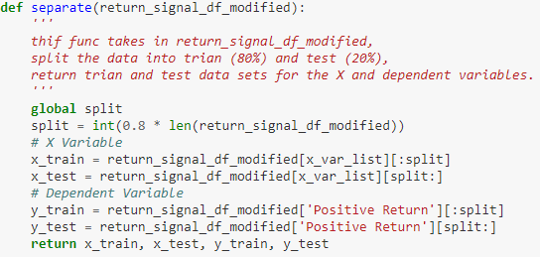
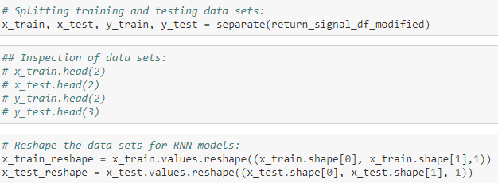
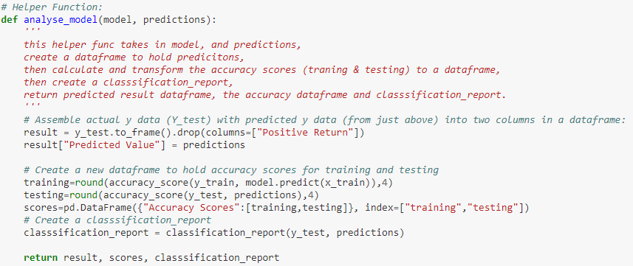
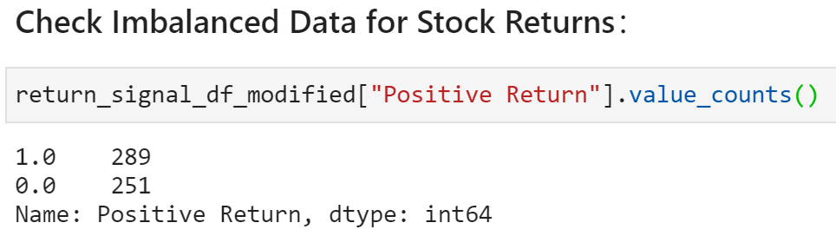
MACHINE LEARNING STRATEGY
FIRST STEPS:
- Creating X and Dependent Variables
- Separate X and Y Training & Testing Datasets
- Machine Learning Models Training

Slide 8
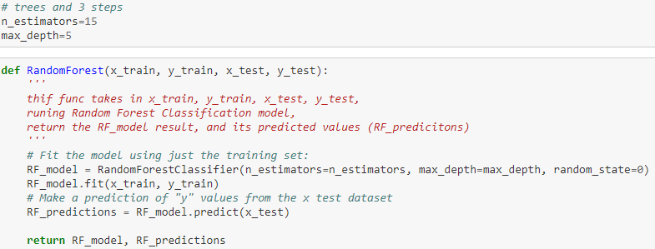
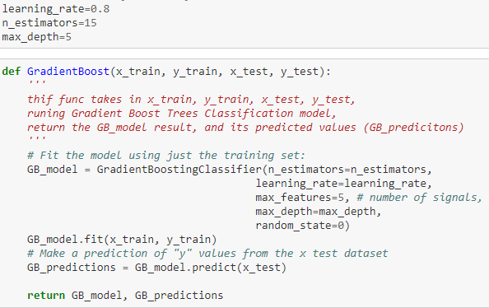
MACHINE LEARNING STRATEGIES
RANDOM FOREST
GRADIENT BOOSTING
Random forest is a combination of decision trees that can be modelled for prediction.
Uses a modified decision tree techniques, used to reduce overfitting effects, eliminating the degradation by ensuring the fitting procedure is constrained.

Slide 9
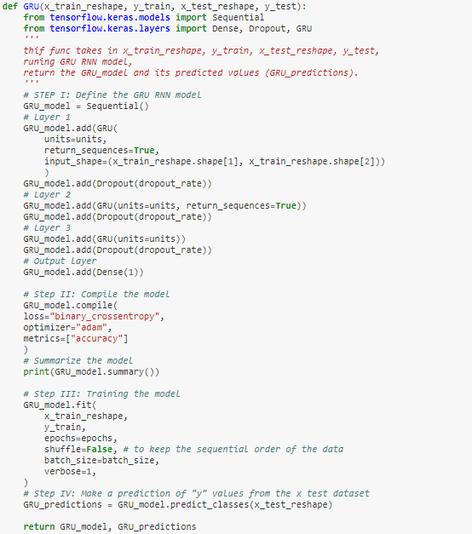
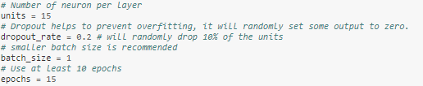
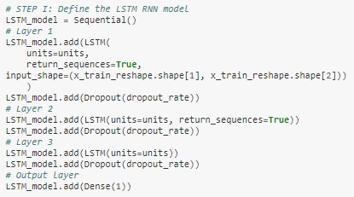
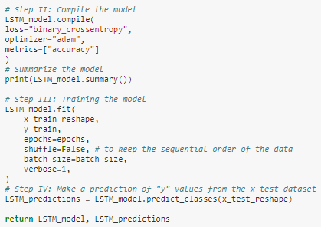
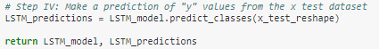
LSTM RNN
NEW GRU RNN
- A neural network model.
- RNNs is a generalised feedforward network, can use internal state (memory) to process sequences of inputs
- LSTM trains the model by using back-propagation to remember past data
Uses a modified decision tree techniques, used to reduce overfitting effects, eliminating the degradation by ensuring the fitting procedure is constrained.

Slide 10
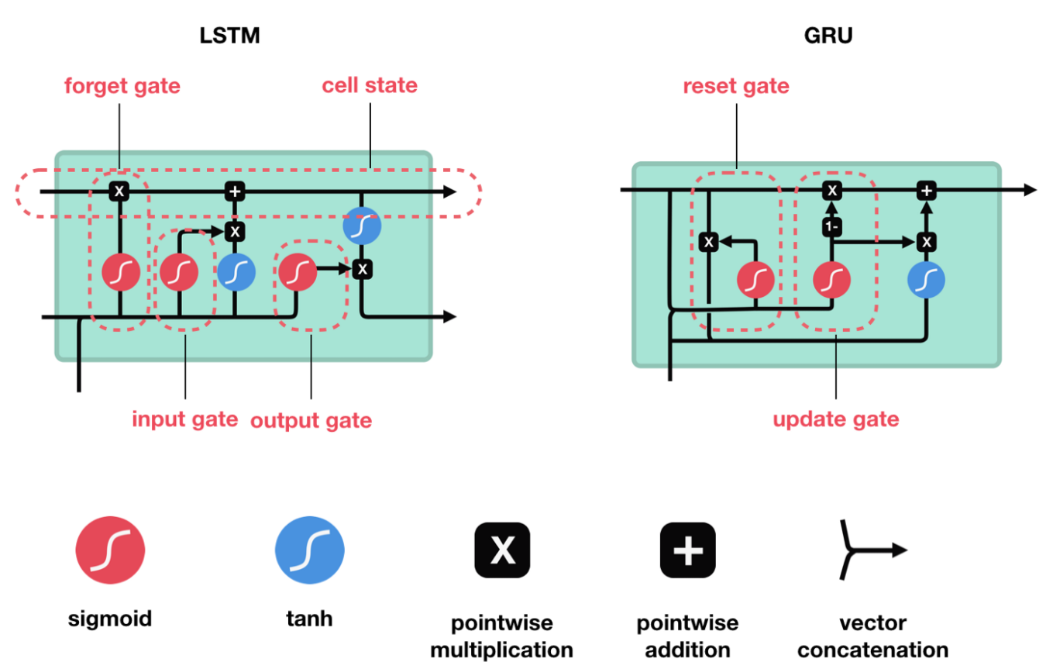
LSTM RNN
GRU RNN (Gated Recurrent Unit)

Slide 11
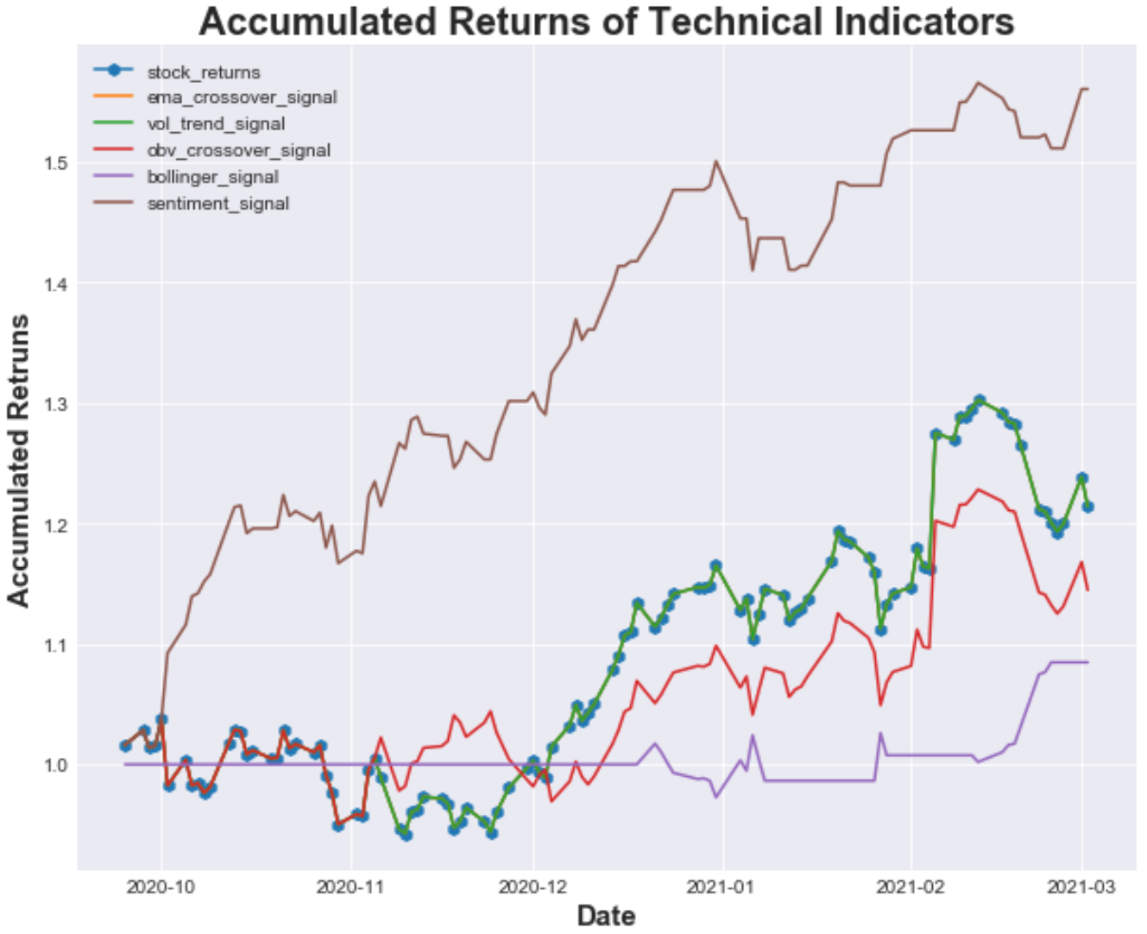
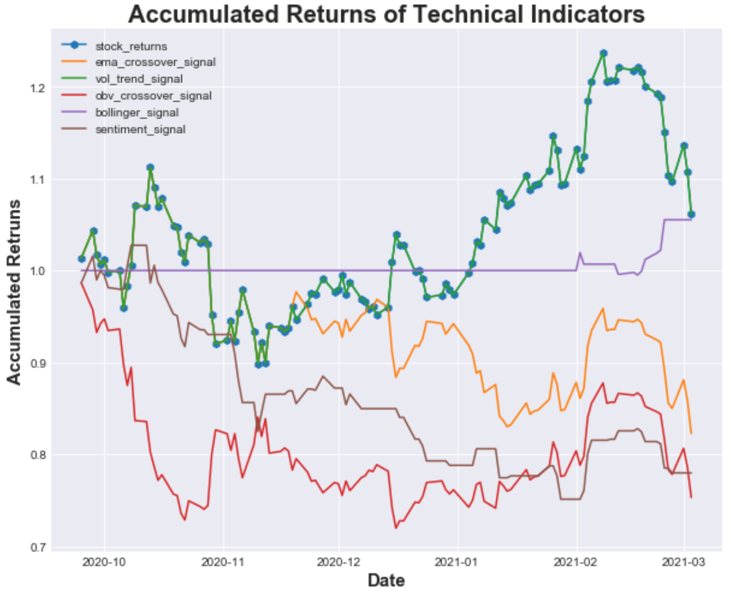
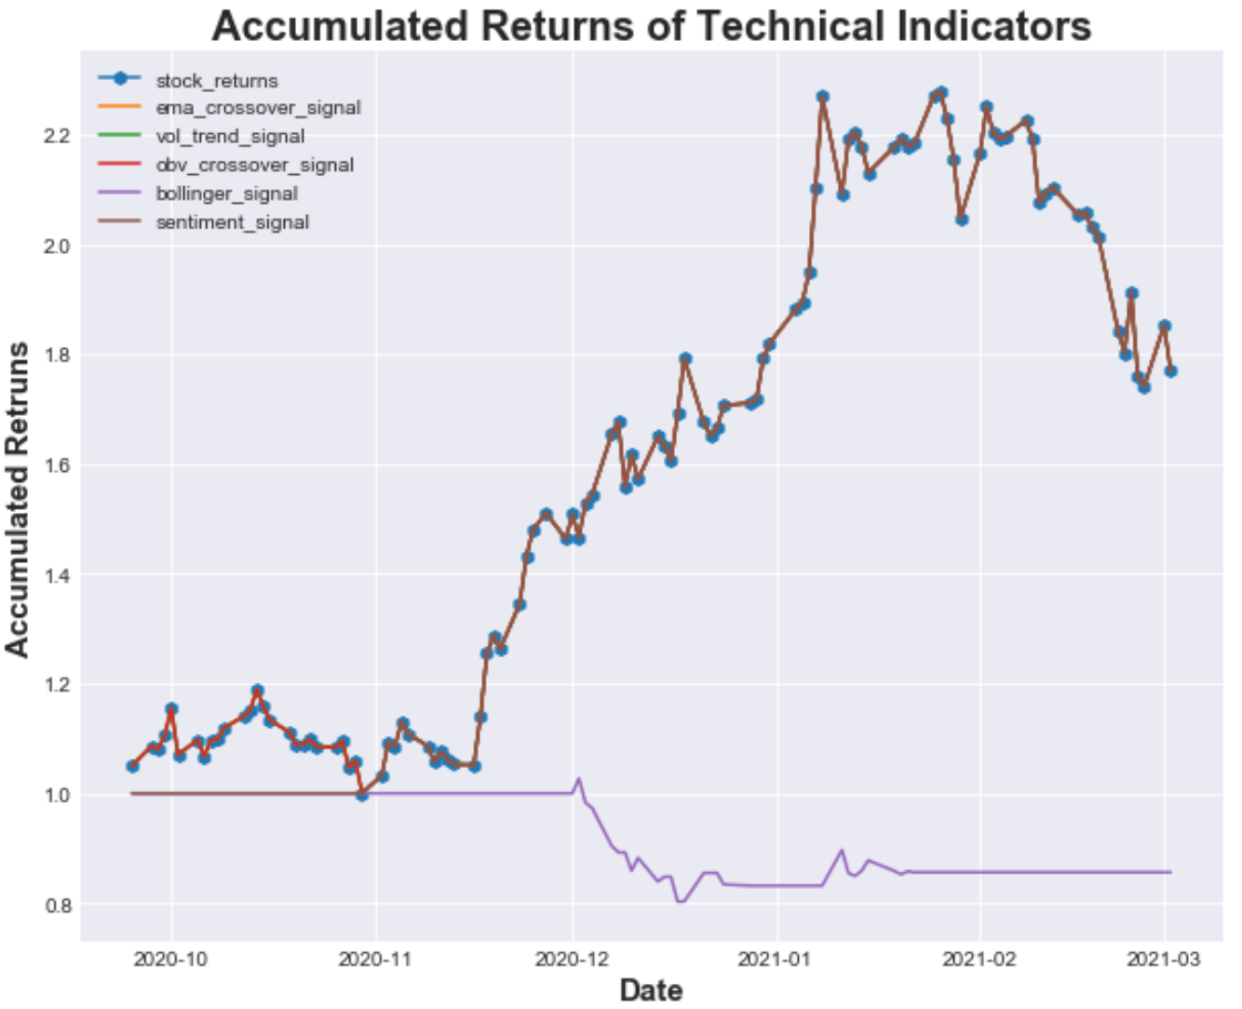
TECHNICAL STRATEGY RESULTS
EBAY
ATVI
TSLA

Slide 12
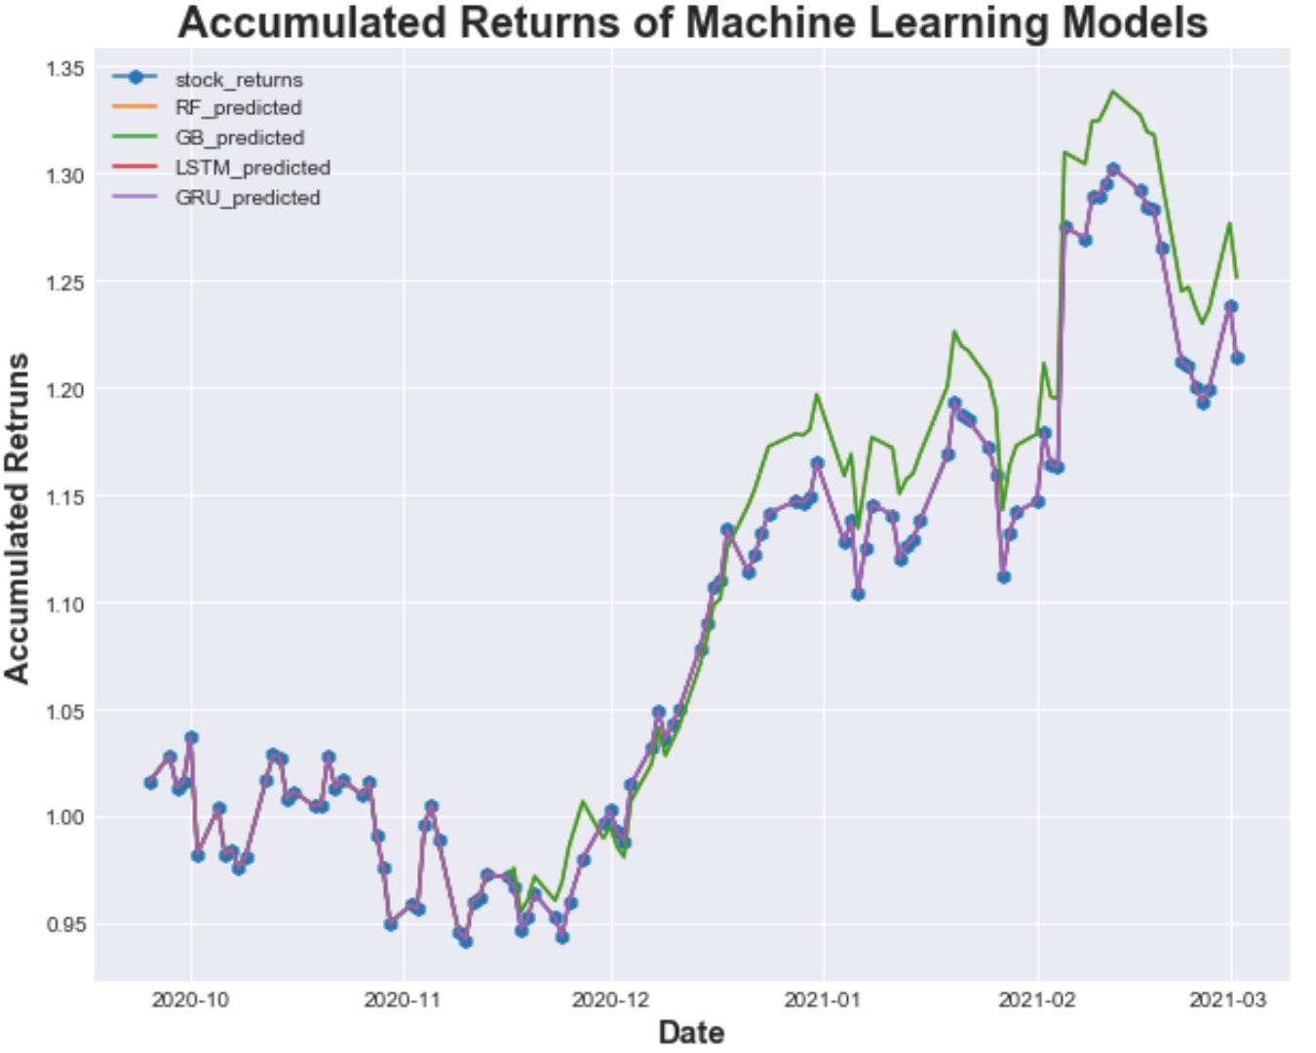
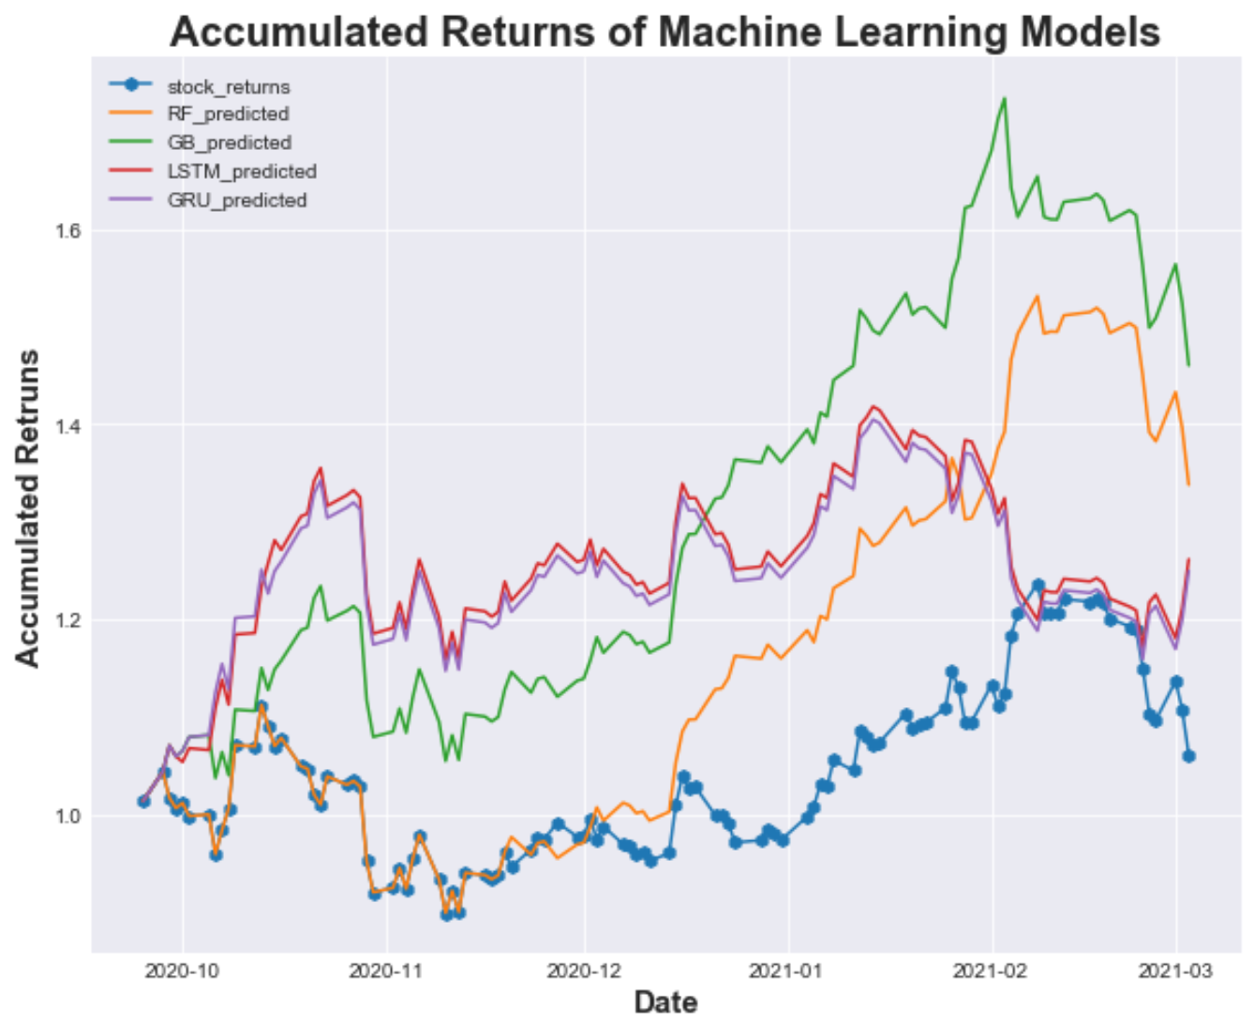
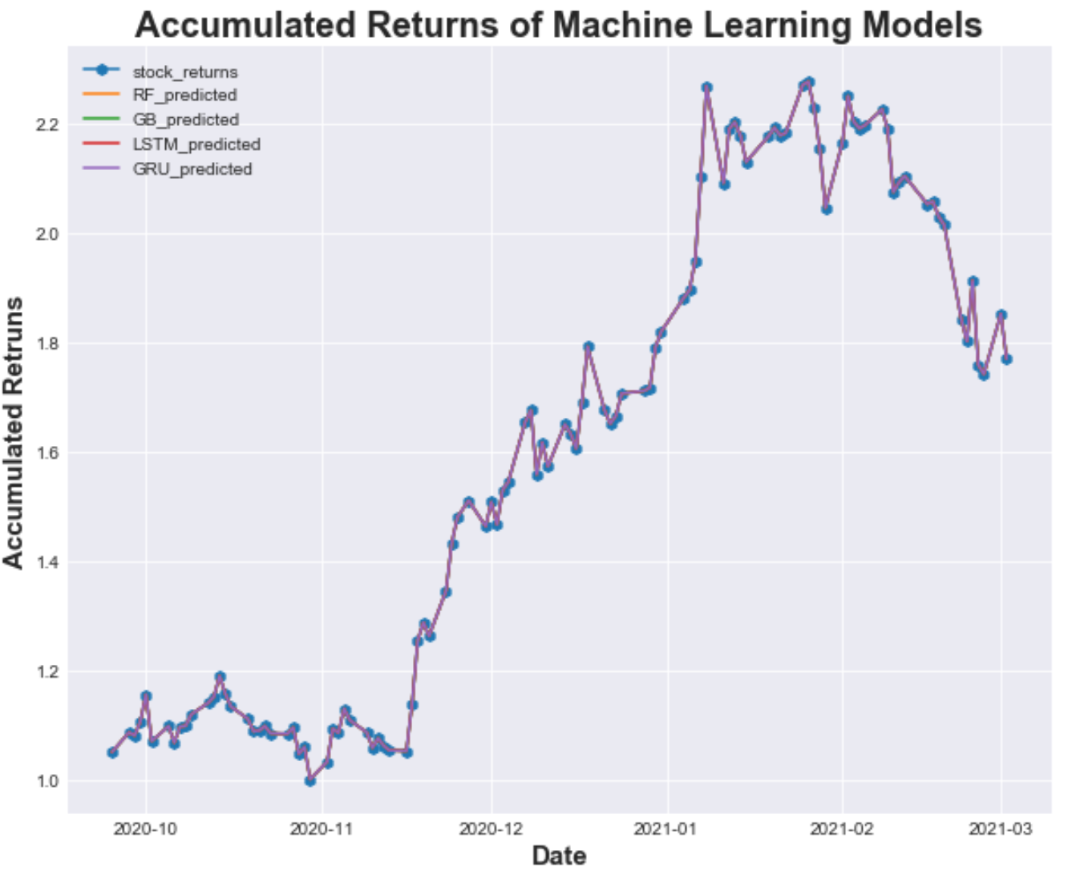
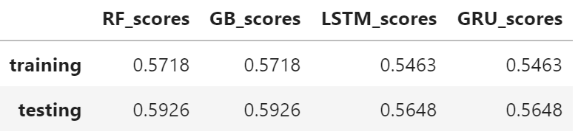
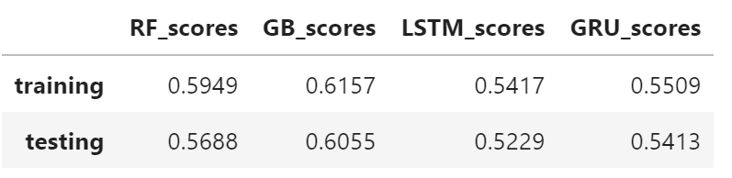
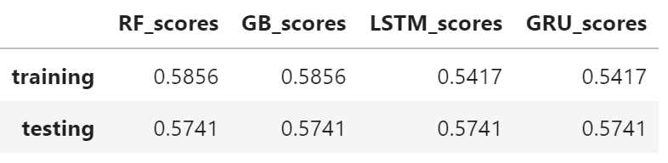
MACHINE LEARNING RESULTS
ATVI
TSLA
EBAY

Slide 13
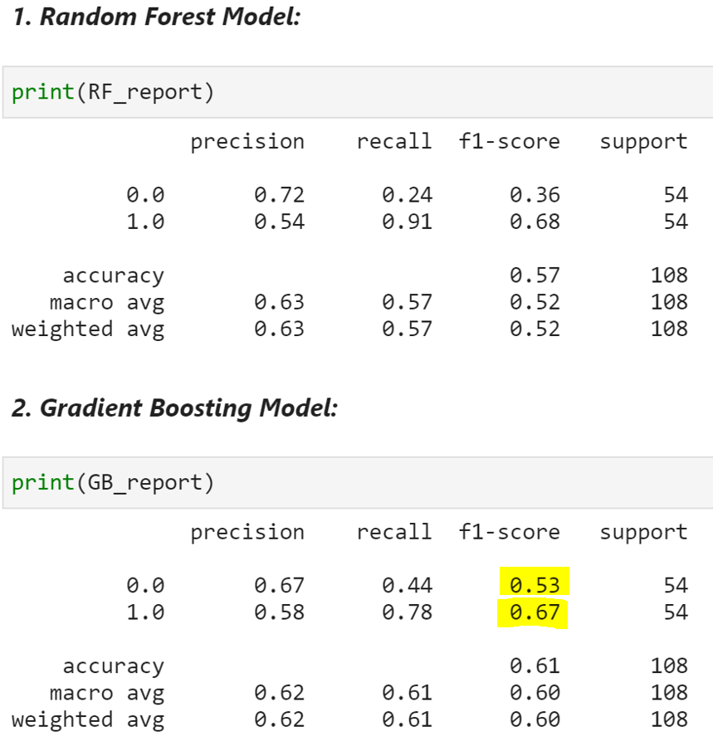
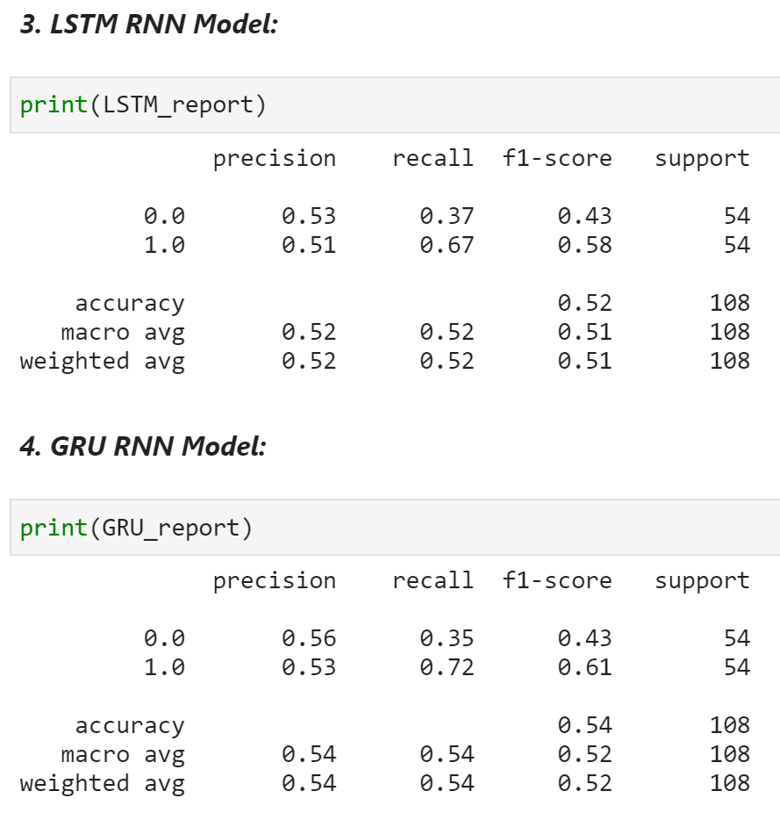
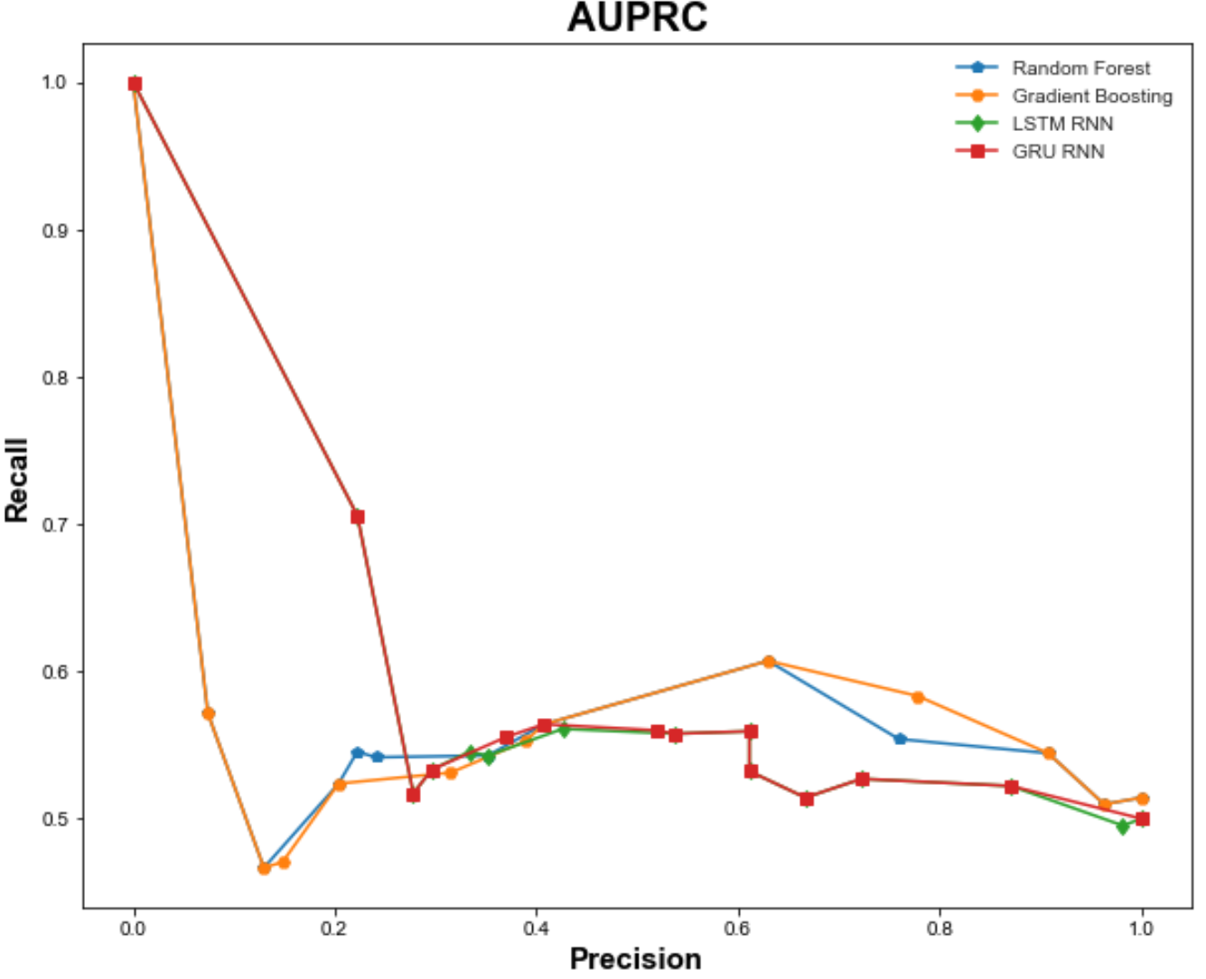
MACHINE LEARNING RESULTS
EBAY

Slide 14
MACHINE LEARNING RESULTS
ATVI
TSLA
EBAY

Slide 15
FUTURE CONSIDERATIONS
More Technical Inidicators
Fundamental Ratios
Test a Conjunction of Indicators

Slide 16
Findings & Improvements
Findings
Technical indicators by themselves usually underperform a buy-hold stock trading strategy
Typically accuracy scores for ML models range from 55% to 60%
Gradient Boosted Tree delivers most promising results
Improvements
Using ML models to combine technical indicators could improve the accumulated returns, improvements in result/accuracy can be made by:
Without the time constraint, more indicators (technical and fundamental indicators i.e ratios) could be included and more test on various combination of hyperparameters could be run
Further analysis still required before applying the ML models to any investment strategy
Carefully selection of hyperparameters of the ML model
Tuning the hyperparameters of the technical indicators according to the trading style
Notes:
(our project is assuming a five-day trading strategy)

Slide 17
Improve Trading Strategies Using Machine Learning
Any Questions?
Notes:
(our project is assuming a five-day trading strategy)

